Slide 1

The History Of Firearms
By: Allison Wynn

Slide 2
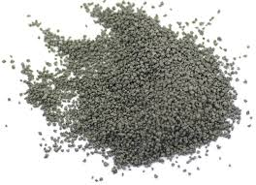
When Was Gunpowder Invented?
Historians estimate as early as 850 A.D, alchemists in China stumbled upon the explosive properties of gunpowder which is a combination of potassium nitrate, sulfur, and charcoal. At first gunpowder was used for fireworks, but it found its way into weaponry.

Slide 3
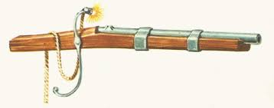
European Firearms
By the 13th century ancestors of the modern firearm had spread from Asia to Europe, where they were further developed as weapons in the form of matchlock, wheel lock, and flintlock firearms. By the time early colonists arrived in America in the 15th century, firearm design had advanced significantly, and the weapons were routinely included in journeys to the new world.

Slide 4
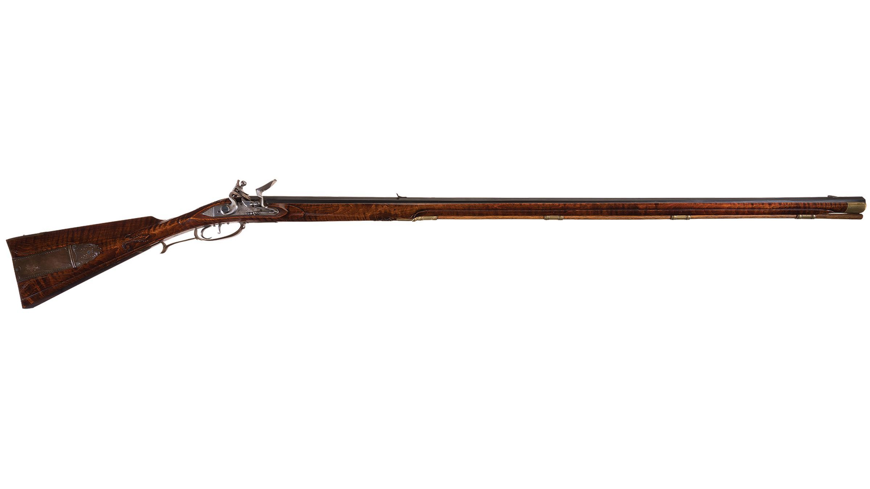
American Gunsmiths
For early settlers pioneering the wilderness of North America, gunsmiths became vital members of small settlements. These skilled metalsmiths developed the American Long Rifle. These rifles were sometimes elaborately carved and decorated with finely etched brass or silver plates. But the rifles most critical quality was its extended barrel that featured twisting grooves along the interior bore. These grooves guided a lead ball to spin as it exited the barrel, ensuring a straighter shot.

Slide 5
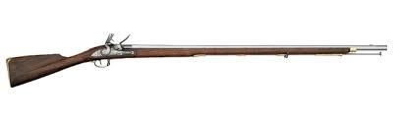
Revolutionary War Firearms
During the Revolutionary War, some American militia fighters used their hunting rifles to take out British soldiers from distant cover. But most militia used a combination of British Brown Bess and French Charville muskets. These weapons offered less precision in aim but were faster to reload. As demand increased to arm the American Revolution, local gunsmiths began to make their own versions of the European-made muskets. The spark used to ignite gunpowder in early American-made weapons was usually generated by a piece of flint striking a metal plate coated in gunpowder.

Slide 6
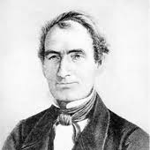
Remington Arms
Around the same time the U.S. government and some states began hiring smaller gun-making outfits to produce guns or gun parts, based on the weapons being produced at U.S. armories. Some of the oldest gun makers got their start then, including Eliphalet Remington, who began producing flintlock rifles in 1816. Remington Rifles has persisted to current times.

Slide 7
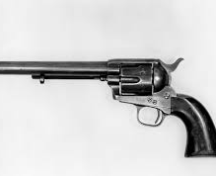
The Colt .45
In 1836, Samuel Colt received a U.S. patent for a handheld pistol that featured a mutli-firing system based on on a rotating barrel with multiple chambers that could fire bullets with multiple chambers that could fire bullets through a lock and spring design.

Slide 8
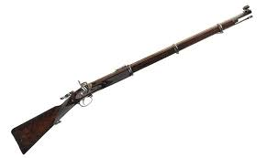
Civil War Firearms
Just before the start of the 20th century, Colt, followed by Smith and Wesson, would develop revolver cylinders that would swing out to the side for unloading and reloading bullets. The so-called 'double action" design would dominate revolver models throughout the 20th century. To avoid this problem, gunsmiths developed new types of ignition systems that protected gun powder from the elements. The percussion system, developed in 1807, used a small copper cap filled with charge. The cap was inserted into a “nipple” at the rear of the gun barrel and, when the trigger was pulled, a hammer struck the cap, igniting a spark in the cap and then the gun powder.

Slide 9
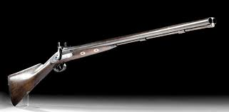
Double-Barrel Shotguns
Rear-loading or breechloading systems developed by gun manufacturers, packed the projectile and powder together in a single, combustible cartridge. The system not only saved time, it also avoided exposing gun powder to wet conditions. Next, gun manufacturers set their focus on speeding up the time required to reload a weapon. Colt’s revolver system offered one method for rapid reloading, but by the mid 19th century, it wasn’t the only game in town. Another concept mounted multiple barrels onto a single stock to gain more bang for every trigger pull. Double-barrel shotguns are still produced today.

Slide 10
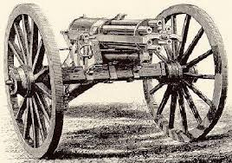
Gatling Gun
Indianapolis, Indiana-based Richard Gatling had created an earlier, more primitive version of the machine gun. In the early 1860s, Gatling received a patent for a hand-cranked, multiple barreled weapon that could fire 200 rounds per minute. The Gatling gun could fire for as long as the gunner turned the weapon’s crank and an assistant fed the machine ammunition.

Slide 11
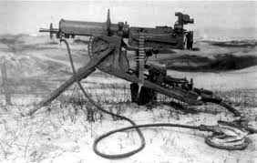
Maxim Gun
The Maxim machine gun of 1884 could fire a barrage of 600 rounds per minute and would soon arm the British Army, and then the Austrian, German, Italian, Swiss and Russian armies. The Maxim gun and its later versions under Maxim’s new company, Vickers, became pervasive in World War I, while German forces used their own versions of the machine gun.

Slide 12
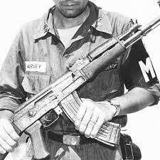
AK-47
Among the most significant firearm inventions during the Cold War era was the AK-47 rifle, developed by Mikhail Kalashnikov for the Soviet military in 1947 (AK stands for “the Automatic by Kalashnikov”). The short-barreled weapon with steep front-sight posts and curved magazines offered the rapid-fire of machine guns with lighter-weight portability. The weapon is gas operated, meaning that a portion of high-pressure gas from the cartridge is used to power the extraction of the spent cartridge and insert a fresh one into the weapon’s chamber. It can fire up to 900 rounds a minute.

Slide 13
Source
https://www.history.com/topics/inventions/firearms

