Slide 1
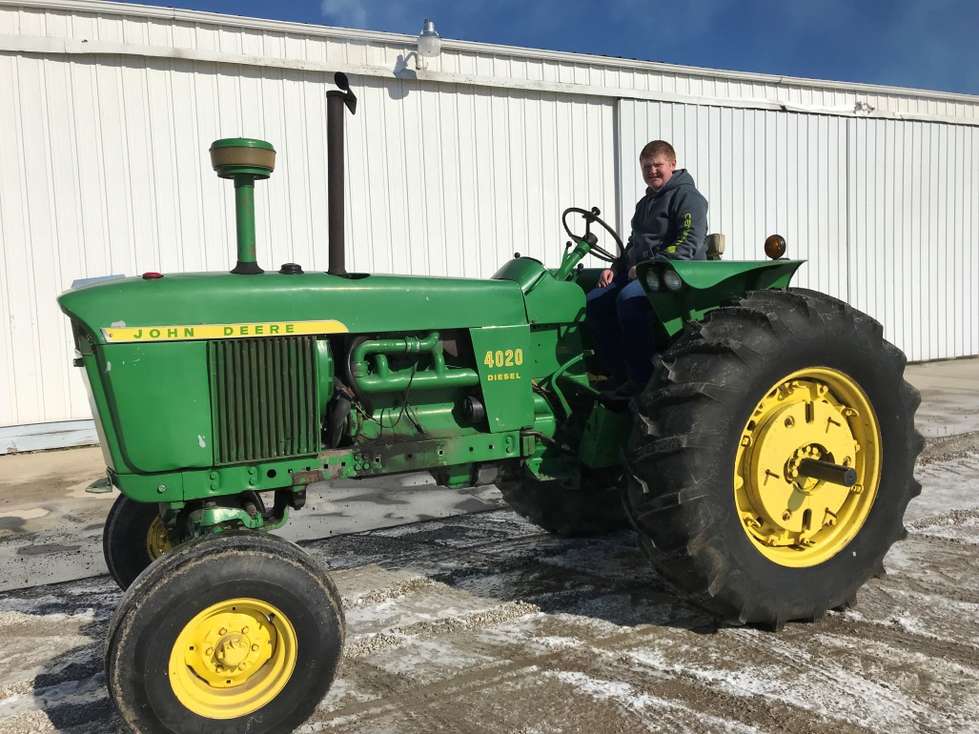
John Deere 4020 Restoration
Conner Grant

Slide 2
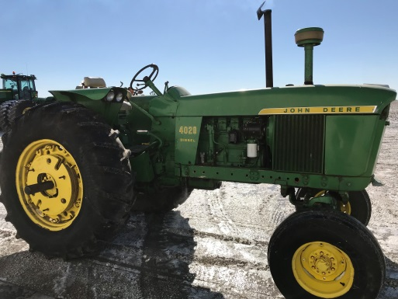
Project Overview
I have a love for older tractors. We have a few on our farm that have been restored. I have always wanted to restore one myself. My chance came when I bought a 1966 John Deere 4020 diesel tractor. The tractor when I bought it was in rough condition. The motor is blown, the paint is in poor condition, and an overhaul is needed. Therefore, as part of both my FFA and 4-H projects I am working to restore this tractor. I purchased this tractor myself. My goal is to have it restored to show room condition by the end of my senior year in high school.

Slide 3
Financial investment
The funds I need to invest in my project are from savings and profits from my other FFA projects, grain production. My main cash expense categories are: parts, paint, engine rebuild kit, and tires. In terms of cost my budget is around $8-10,000.00. Planned income for my project will be a fully restored JD 4020 valued at $15,000.00.

Slide 4
Learning Objectives
When I purchased the tractor, it already had new rear tires. Also, the previous owner had Sloan Implement put a new clutch and rear end in the tractor. I will learn the following mechanical concepts from this project: First, I will learn how to use a variety of shop tools. Second, I will learn how to overhaul an engine. Sloan Implement has volunteered to help me with this part of the project. Third, I will learn the true expense of parts and labor. In addition, I will learn how to work on electrical/charging systems.

Slide 5
Current progress
I purchased the tractor in 2019. So far, I have removed all of the sheet metal from the tractor and fenders. In addition, I removed the real wheel weights. My next step was to start overhauling the engine. Like I said earlier, Sloan Implement has volunteered to help me with this. Late winter I made arrangements with them to get started and took my tractor to their shop. Then, Covid 19 hit. My project came to a complete standstill. Fingers crossed, I am looking forward to getting back at it in just a few short weeks. My goal is to have the tractor completed in the next few months.

Slide 6
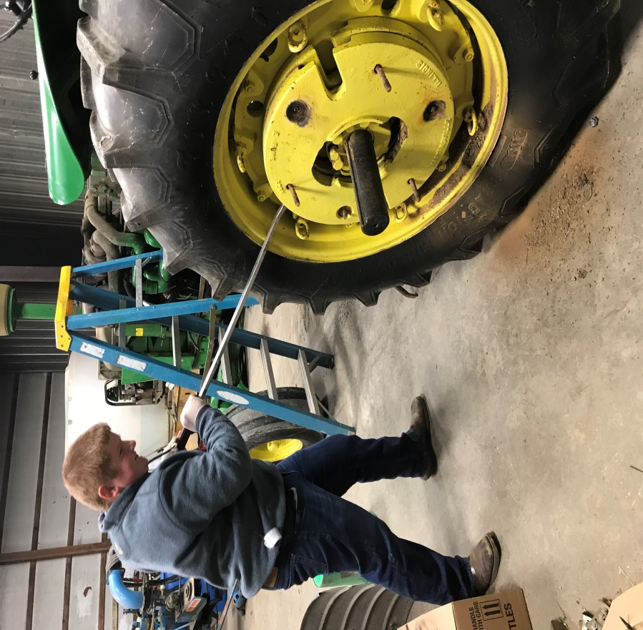
Removing wheel weights

Slide 7
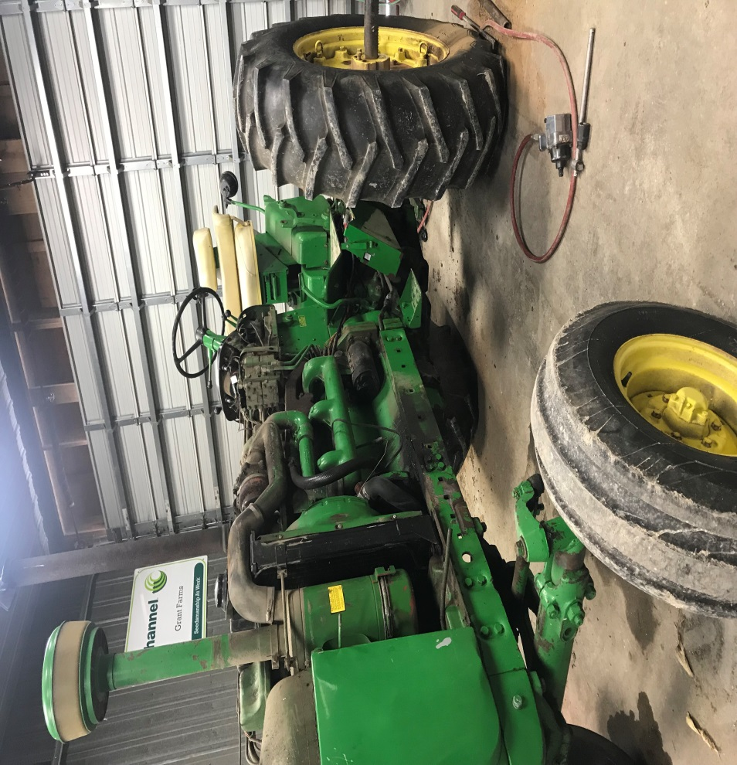
Removing sheet metal and fenders

Slide 8
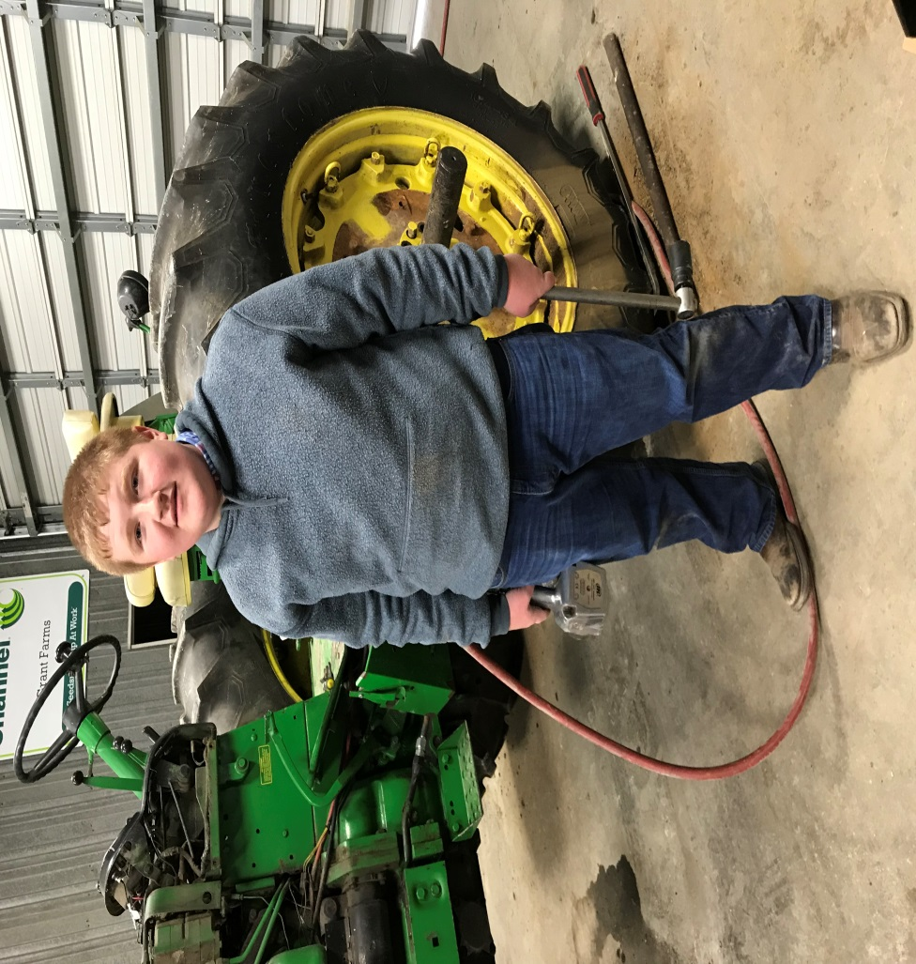
attempting to get rear wheels loose on the axle

